Slide 1
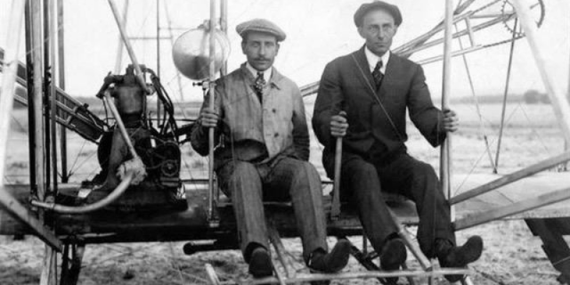
The wright brothers
History of Flight

Slide 2
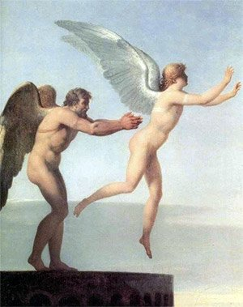
The idea of flight
“What would it be like to fly like a bird does?”
The Greeks had the Myth of Daedalus and Icarus
Daedalus made wings of wax and feathers
Other ancient cultures (China, India)
Medieval ages too
Leonardo Da Vinci’s flying machines

Slide 3
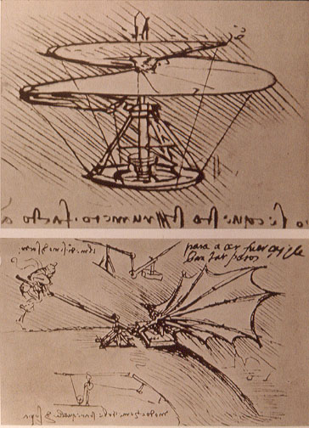
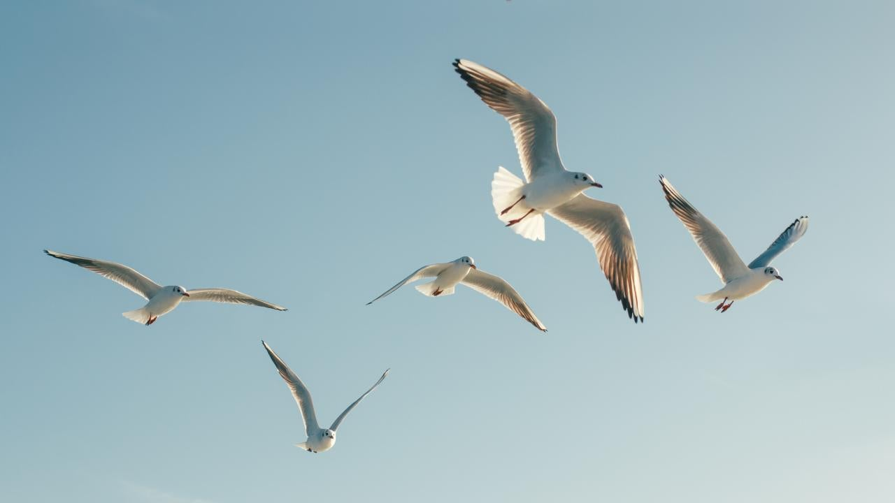
The inspiration
Flight of the birds
The flapping of wings

Slide 4
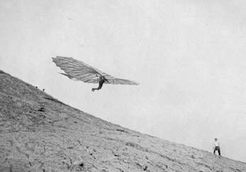
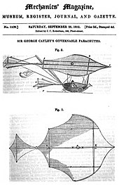
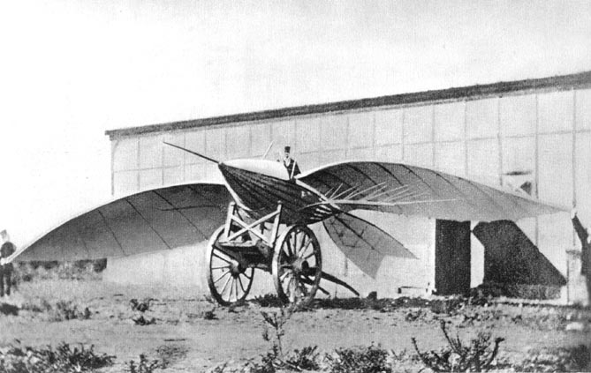
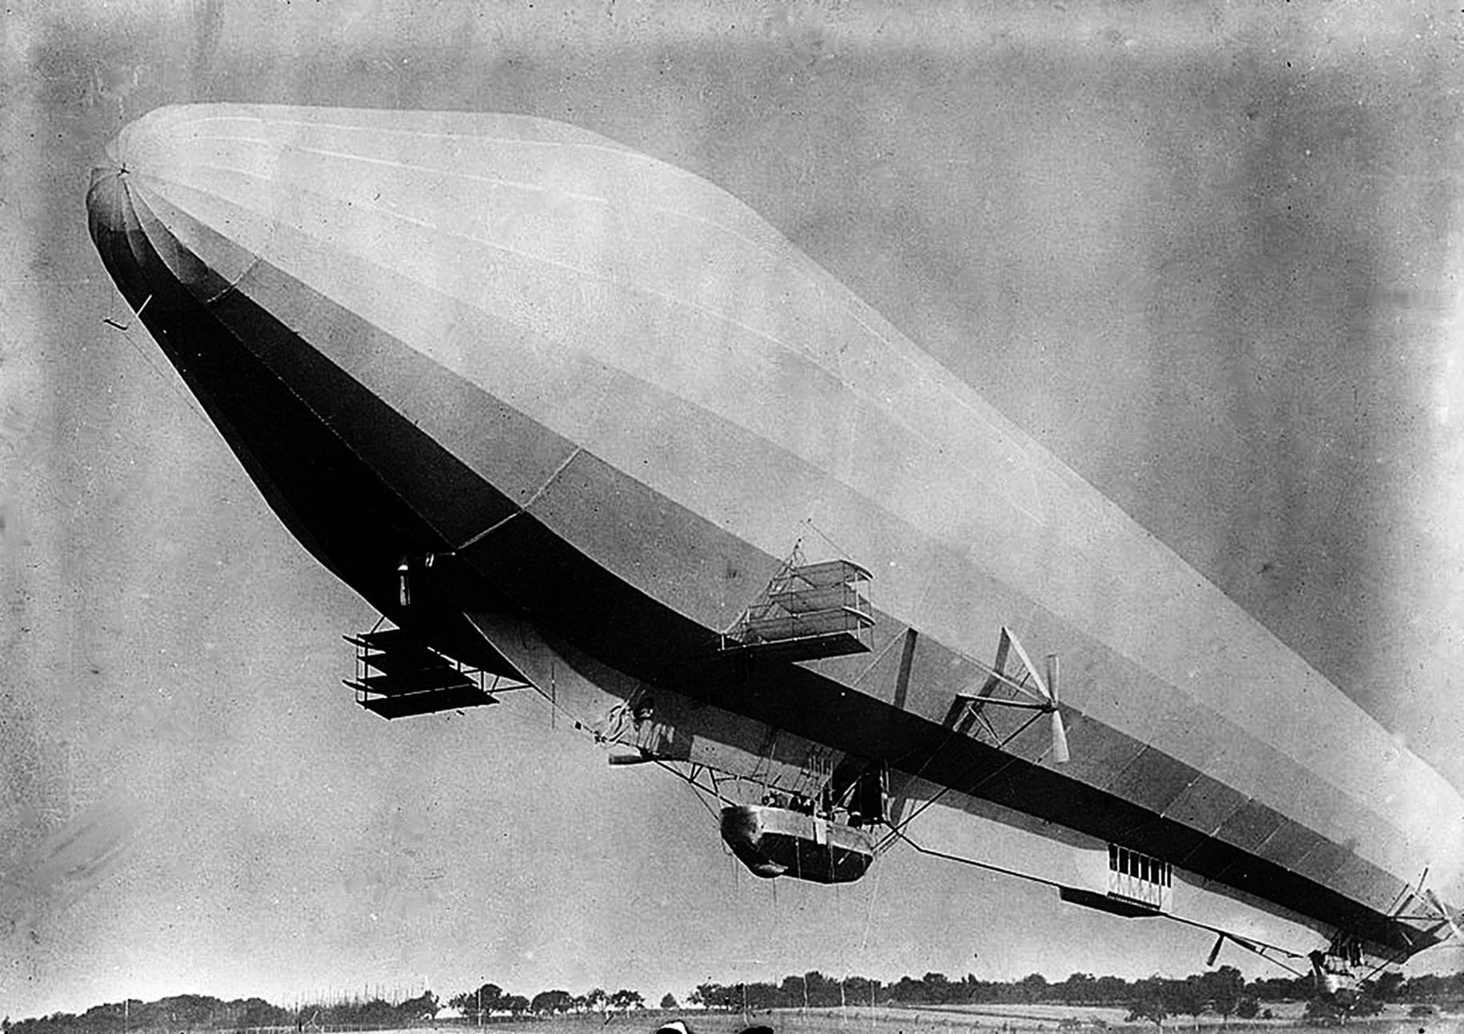
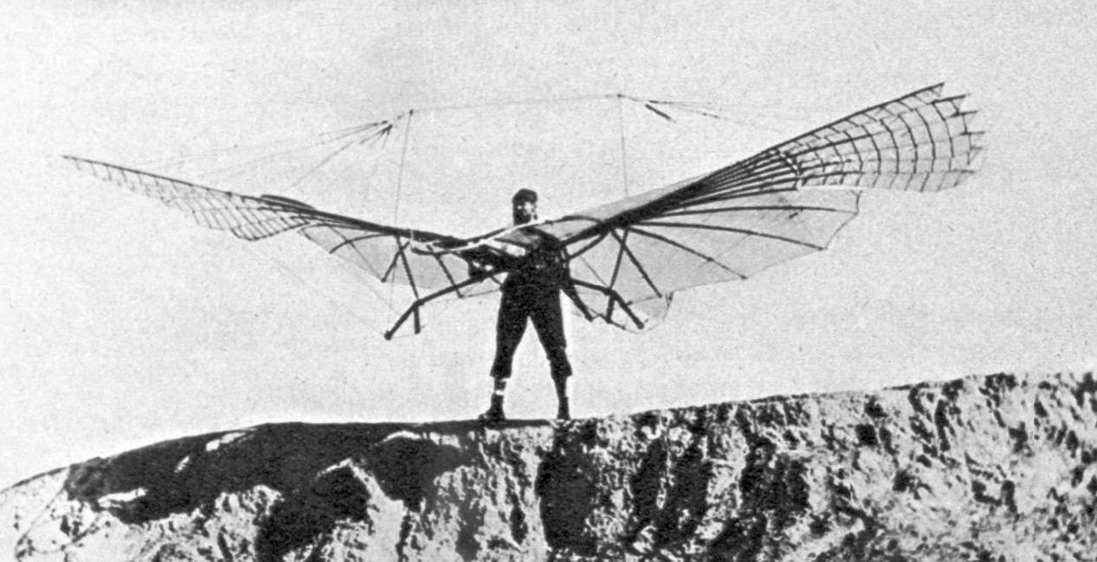
Various ideas
Balloons
Kites
Zeppelins

Slide 5
The problem of flight
Keep the aircraft in the air for a period of time
Make controlled maneuvers with the aircraft
Safely land
Bonus points: use an engine to power the aircraft
Problem: it gets heavier

Slide 6
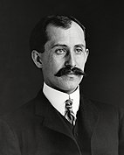
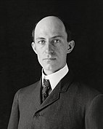
The wright brothers
Orville and Wilbur Wright
Father a bishop
Moved often
Settled in Dayton, Ohio
Finished school in the late 1880s
Without diploma
Ran a bicycle repair shop
In 1878 got a toy helicopter which lit a spark

Slide 7
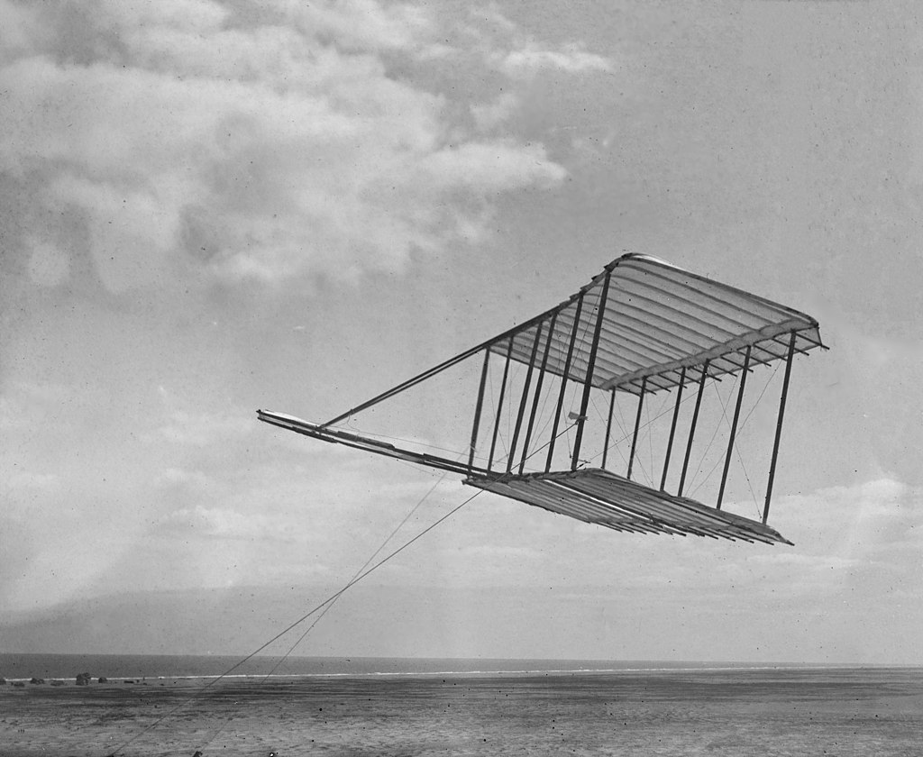
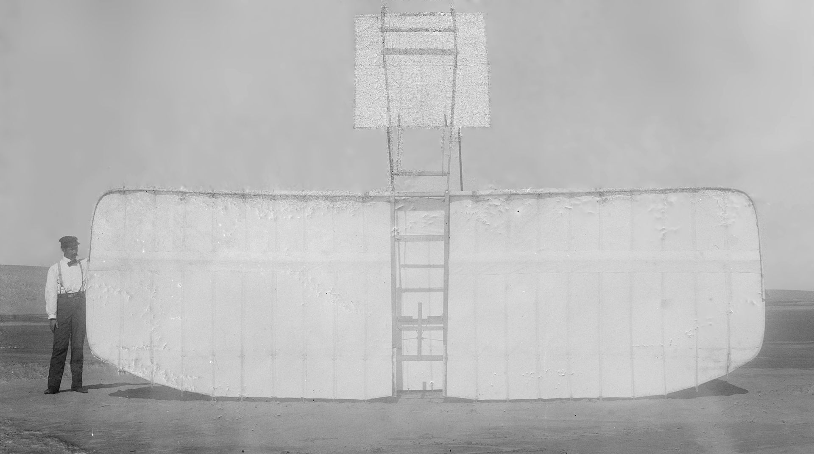
The wright brothers experiments
In late 1890s, experimented a lot
Built a glider
Made many tests
iterated their design

Slide 8
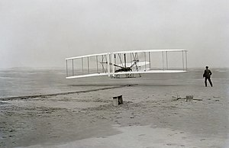
The wright Flyer
Brothers experimented
Built gliders
Achieved a sustained flight
Powered aircraft
On 17th Dec 1903
At Kitty Hawk, NC, USA

Slide 9
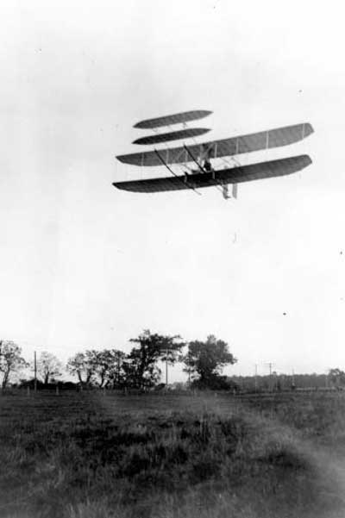
The wright Flyer III
No coverage for their achievements
Meanwhile, brothers flew for fun
October 4th 1904, flight 33 min 17 sec
Didn’t want to demo without a contract
Were called in press: “Fliers or liers?”
Years passed
Brothers worked on scientific measurements

Slide 10
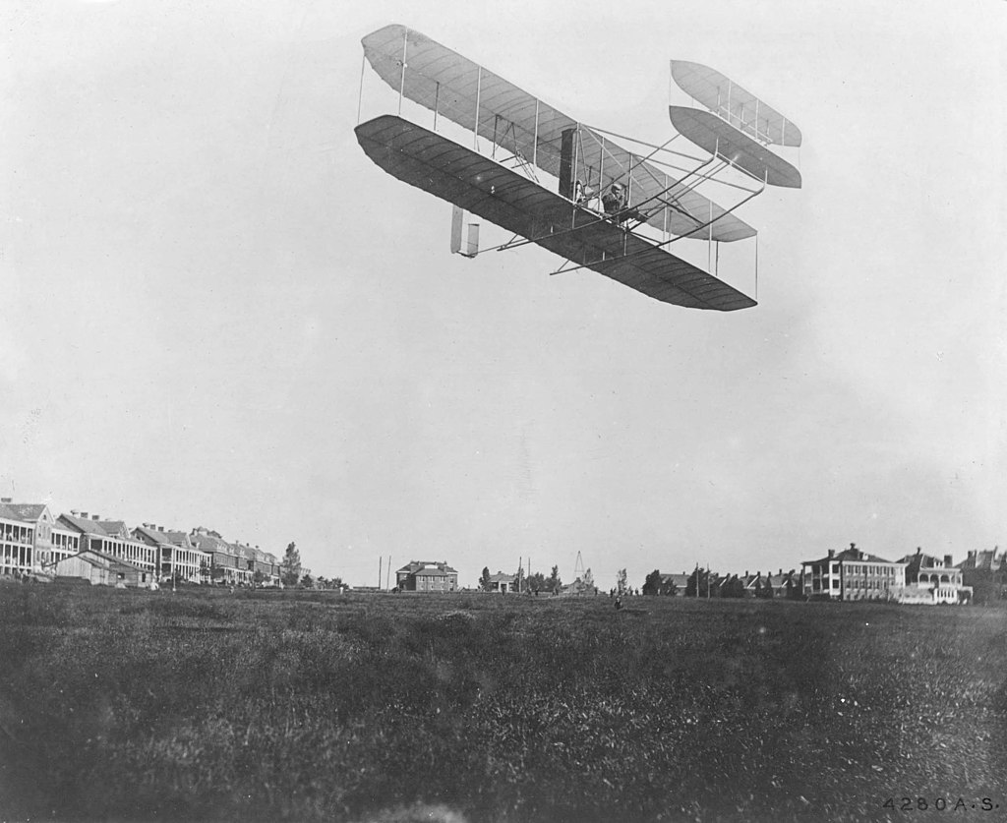
Worldwide recognition
Demo in September 1908
Orville in the U.S.
Wilbour in France
Effortless control
Instant recognition

Slide 11
